Slide 1
Defensive Security Project
by:
Marc Antosz, Keegan Young, Shan Majeed, Ryan Whittaker, Jordan Mcelhinney, and Sara Majeed

Slide 2
Table of Contents
This document contains the following resources:
Monitoring Environment
Attack Analysis
Project Summary & Future Mitigations

Slide 3

Monitoring Environment
‹#›

Slide 4
Scenario
Group 2 consists of a group of SOC Analyst working at Virtual Space Industries (VSI). VSI received intel that their competitor JobeCorp, is planning to launch an attack to disrupt VSI.
In order to help prepare for such an attack, group 2 has been tasked with creating a Sec Monitoring Environment.
In order to accomplish this task, group 2 has implemented the use of Splunk by aggregating different logs in order to: understand their current activities and create baselines for normal usage, creating alerts, creating reports, and dashboards to to further monitor the environment.
After some time had passed… JobeCorp attacked! During the attack JobeCorp took down several of VSI’s servers. Using the environment created, group 2 must quickly act to understand what took place.

Slide 5
Logs Analyzed
Windows Logs
Apache Logs
1
2
windows_server_logs.csv
signature_id
signature
user
status
severity
apache_logs.txt
method
referer_domain
status
clientip
useragent

Slide 6
Windows Logs
‹#›

Slide 7
Reports—Windows
Designed the following reports:
Report Name | Report Description
Signature ID Table | Displays each signature with their matching ID
Severity Chart | Displays the count of events by severity; Informational and High
Status Chart | Displays events by their status; Success or Failure
Status = Failure | Displays the count of events by status=”failure” over time in 1 hour intervals

Slide 8
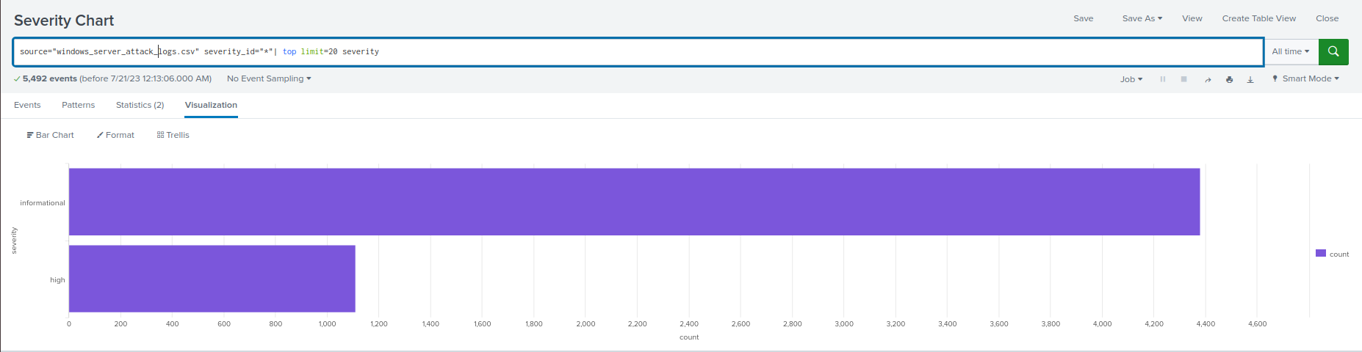
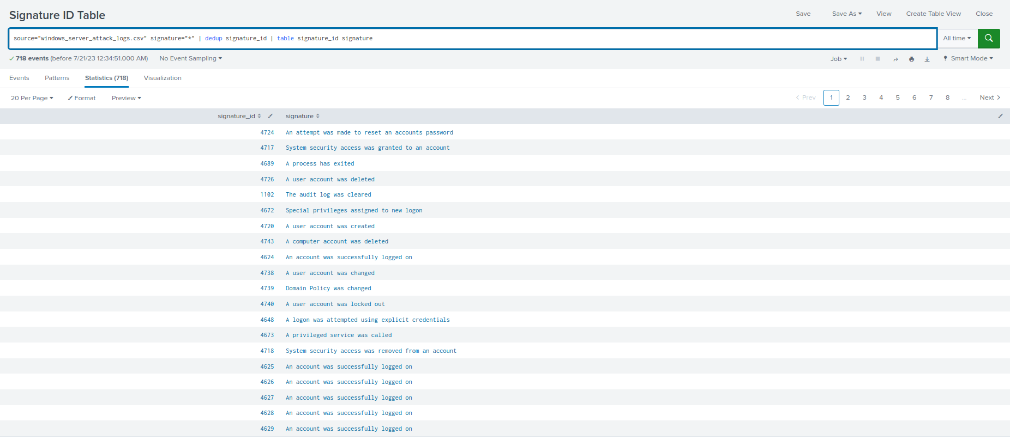
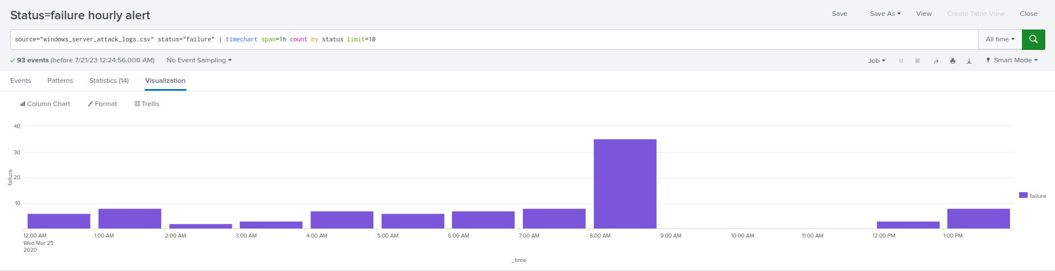
Images of Reports—Windows
Report Image
Report Image
Report Image
Report Image

Slide 9
Images of Reports—Windows
Report Image
Report Image
Report Image
Report Image

Slide 10
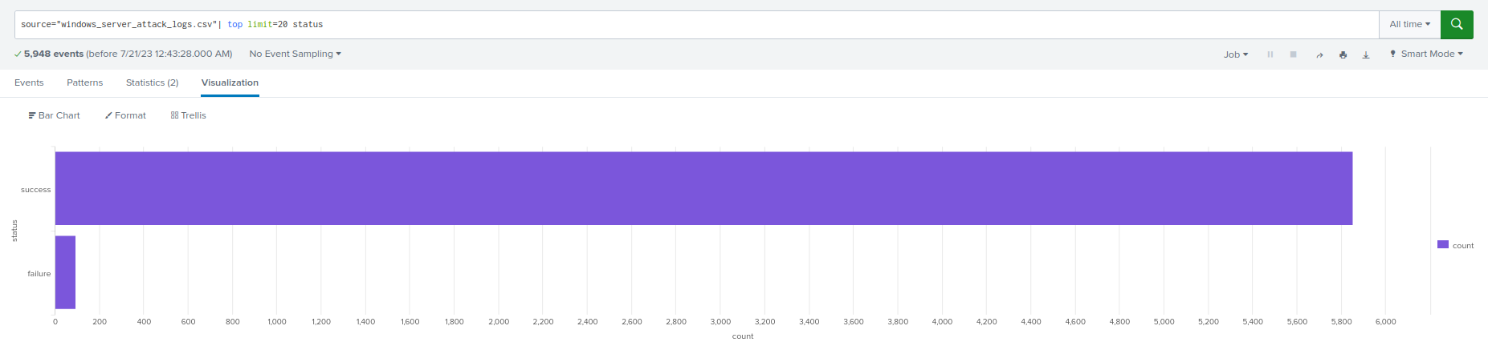
Images of Reports—Windows
Report Image
Report Image
Report Image
Report Image

Slide 11
Images of Reports—Windows
Report Image
Report Image
Report Image
Report Image

Slide 12
Alerts—Windows
Designed the following alerts:
Alert Name | Alert Description | Alert Baseline | Alert Threshold
status=failure | An alert that watches failed activities on the server | 2-10 | 15
JUSTIFICATION: Taking into account the historical data we had was normally distributed with no extreme outliers, we determined baselines based off what would be in the upper extremity of our data. Using an average of those numbers and adding 10%, we determined our baselines.

Slide 13
Alerts—Windows
Designed the following alerts:
Alert Name | Alert Description | Alert Baseline | Alert Threshold
Account Successfullly Logged on | An alert for accounts being logged in successfully on the server | 8-21 | 30
JUSTIFICATION: After viewing the average per hour, we set the threshold to 30. The threshold could be changed upon review in the future.

Slide 14
Alerts—Windows
Designed the following alerts:
Alert Name | Alert Description | Alert Baseline | Alert Threshold
User Account Deleted | An alert for suspicious numbers of accounts being deleted on the server | 9-17 | 30
JUSTIFICATION: This threshold was set high enough to avoid constant alarming by normal activity but low enough to alert for suspicious activity.

Slide 15
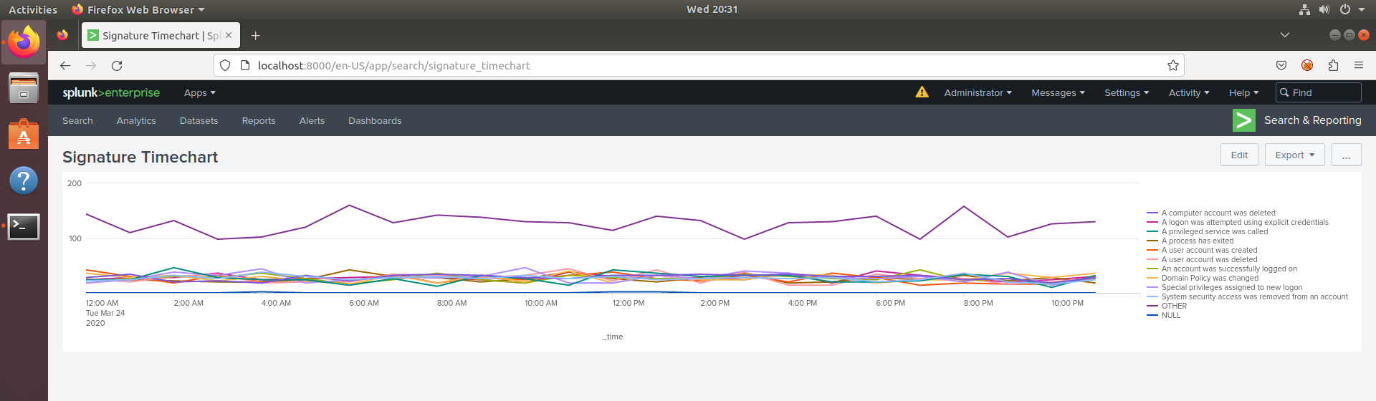
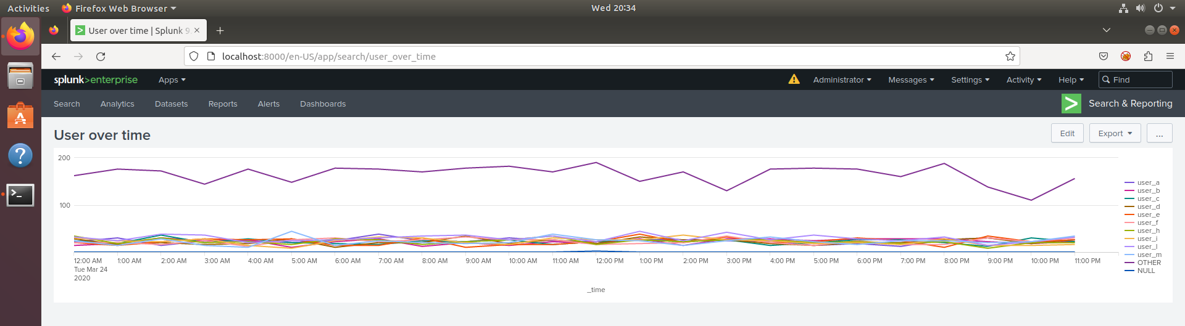
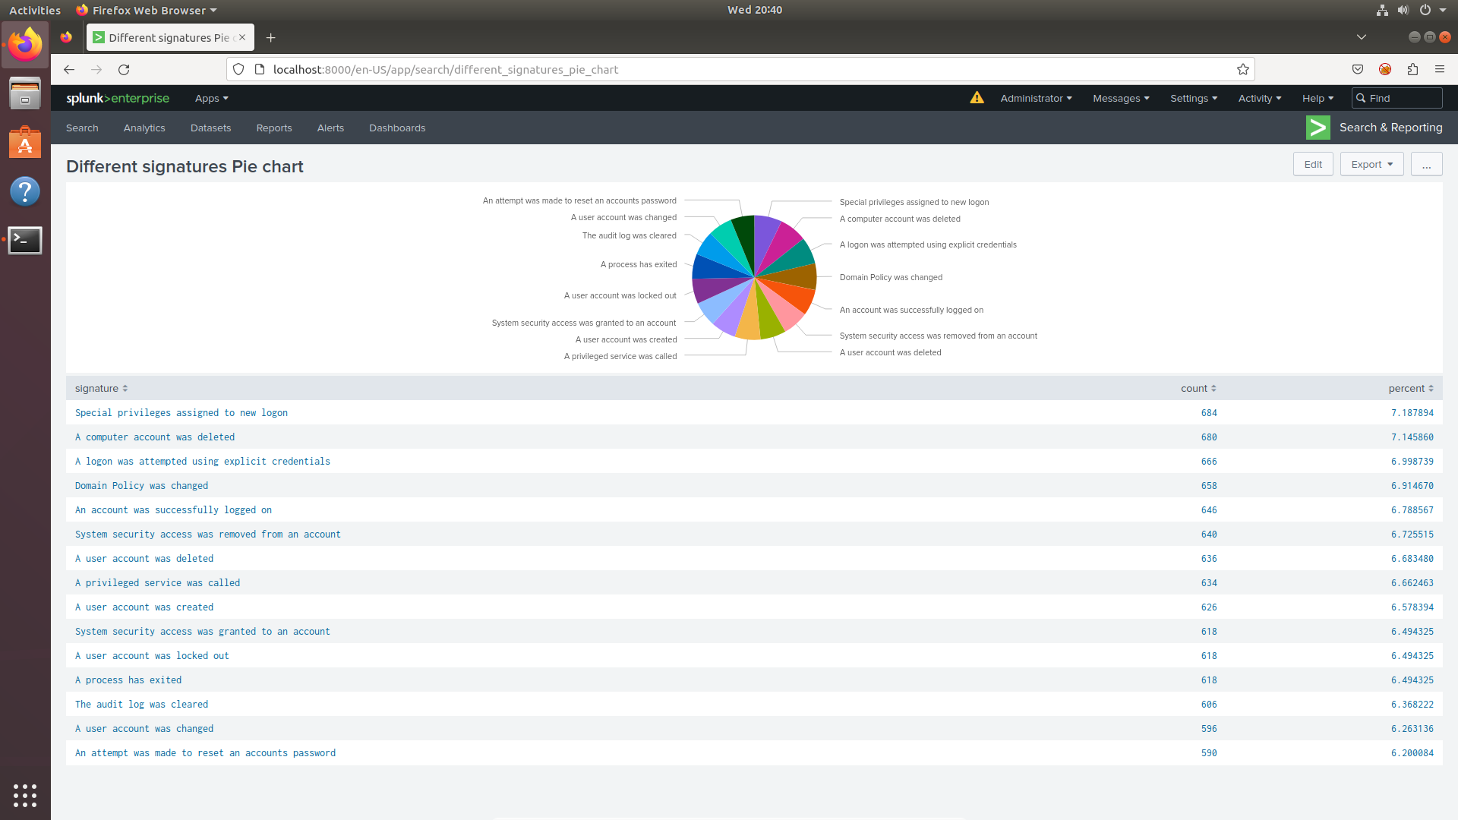
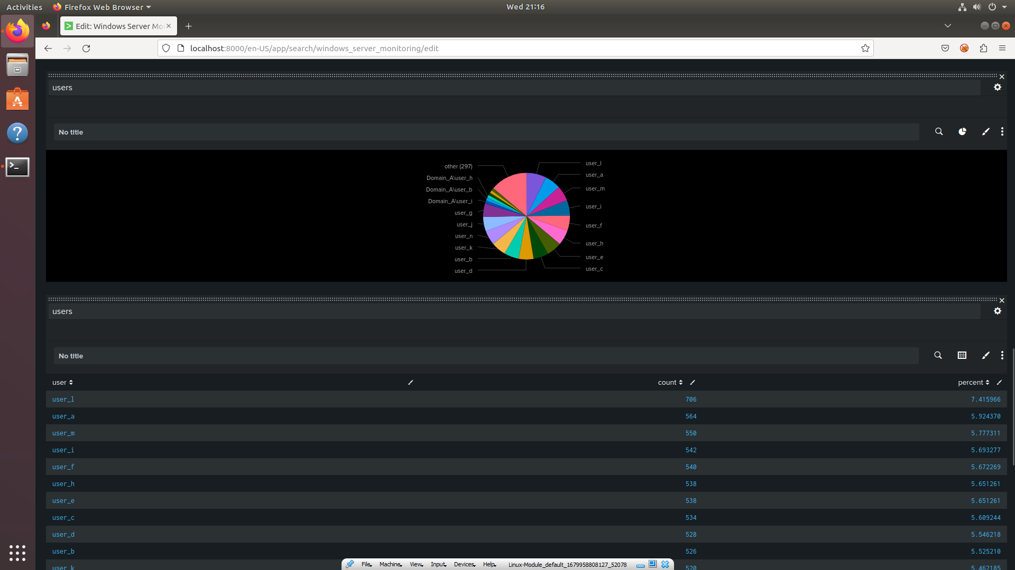
Dashboards—Windows
Place image here
Place image here
Place image here
Place image here

Slide 16
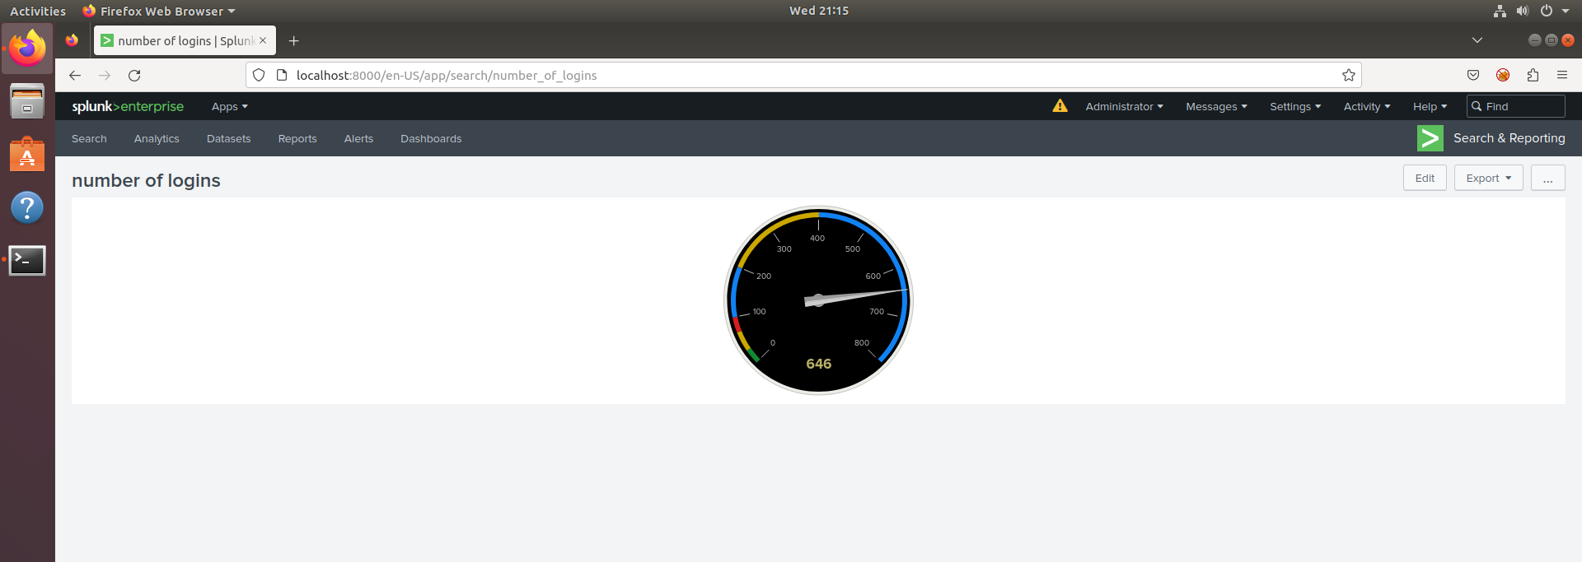
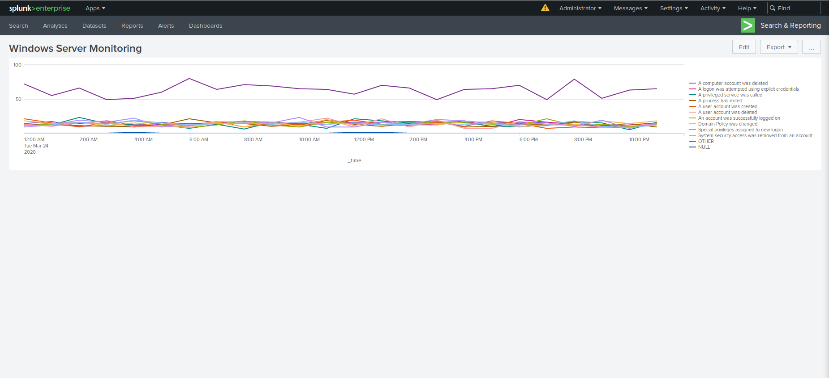
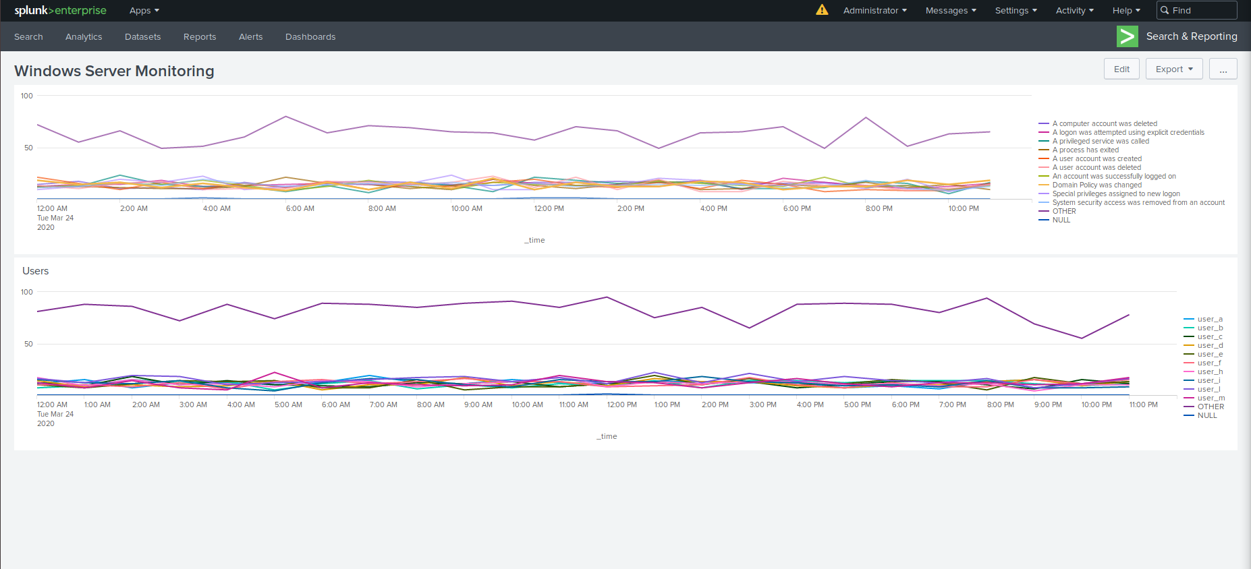
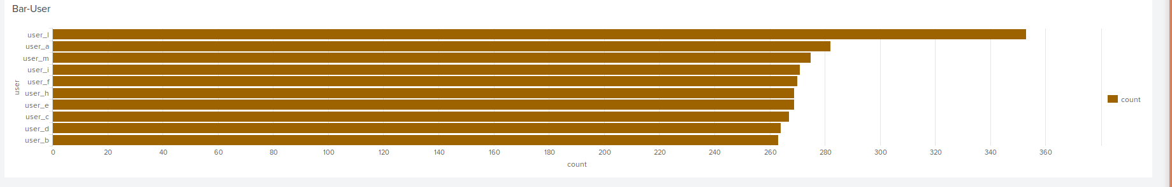
Dashboards—Windows
Place image here
Place image here
Place image here
Place image here

Slide 17
Apache Logs
‹#›

Slide 18
Reports—Apache
Designed the following reports:
Report Name | Report Description
HTTP METHODS | Report on the frequency of values: GET, POST, HEAD, OPTIONS. This will provide insight into the type of HTTP activity being requested against VSI's web server.
TOP 10 DOMAINS | Reports on the various different websites visited by users. This will assist VSI with identifying suspicious referrers.
COUNT OF EACH RESPONSE CODE | Reporting detailing the response code web browsers gave. This will provide insight into any suspicious levels of HTTP responses.

Slide 19
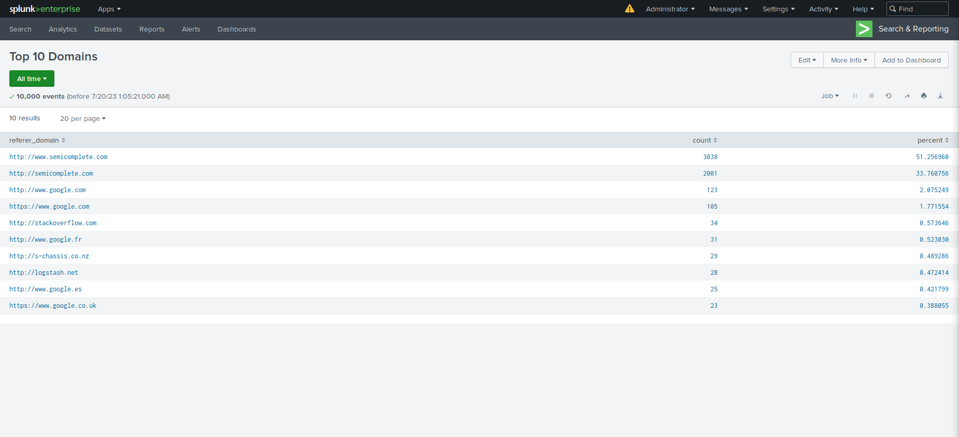
Images of Reports—Apache
Report Image
Report Image
Report Image
Report Image

Slide 20
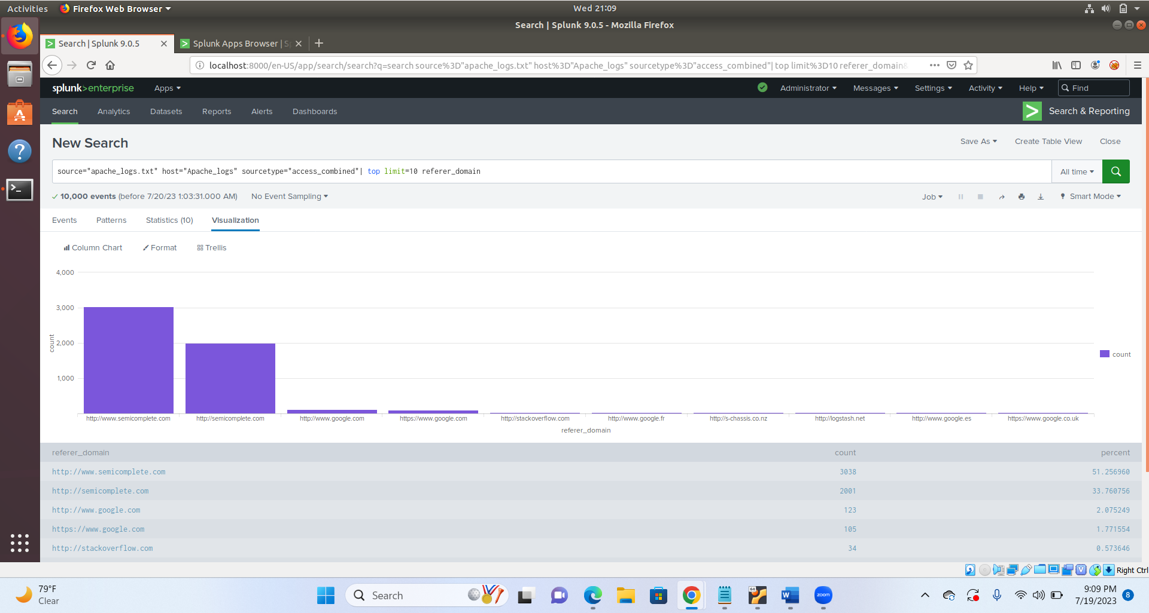
Images of Reports—Apache
Report Image
Report Image
Report Image
Report Image

Slide 21
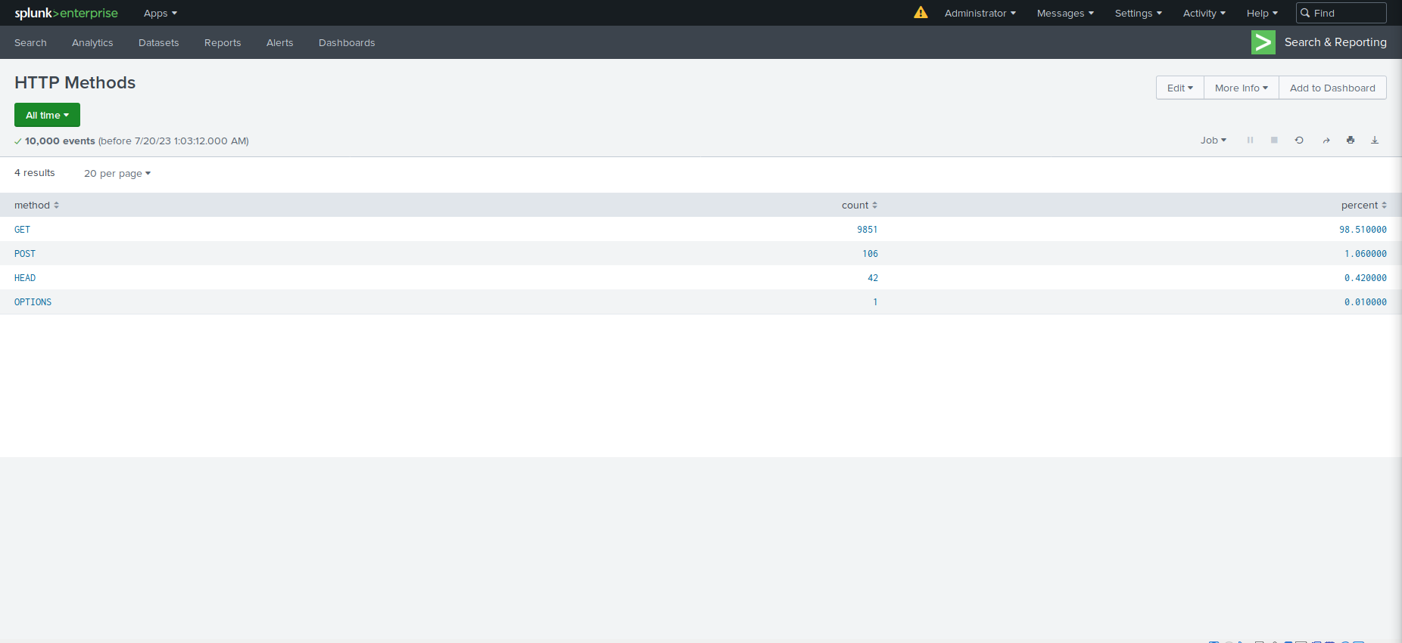
Images of Reports—Apache
Report Image
Report Image
Report Image
Report Image

Slide 22
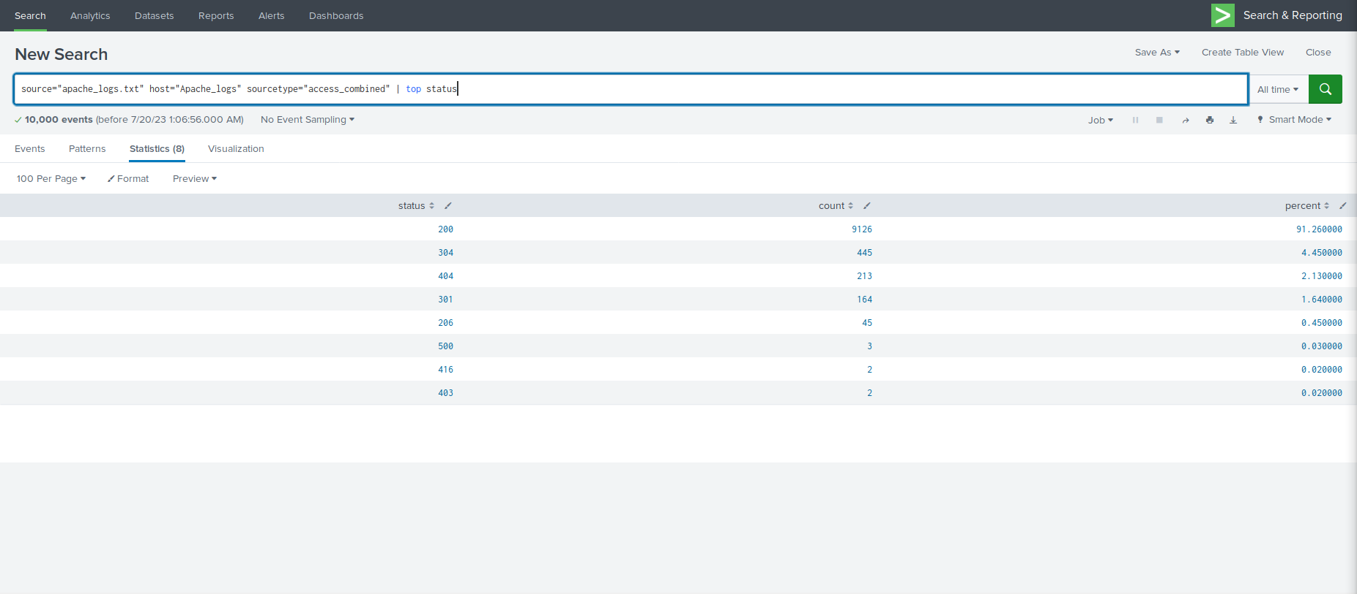
Images of Reports—Apache
Report Image
Report Image
Report Image
Report Image

Slide 23
Alerts—Apache
Designed the following alerts:
Alert Name | Alert Description | Alert Baseline | Alert Threshold
POST Alert | Provides an alert and email when hourly threshold of HTTP post methods are exceeded | 1-7 | 15
JUSTIFICATION: Based on the logs we received, the average that was viewed guided us in choosing our threshold for this alert.

Slide 24
Alerts—Apache
Designed the following alerts:
Alert Name | Alert Description | Alert Baseline | Alert Threshold
Outside US Alert | Gives an alert and an email when the threshold has been exceeded | 80 | 180
JUSTIFICATION: After reviewing the provided logs and gauging the average each hour, we concluded that a good threshold would be 180 to provide space for spikes but still alert on unusual activity

Slide 25
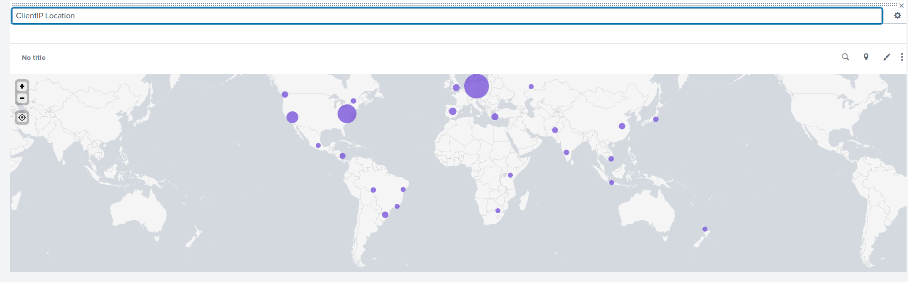
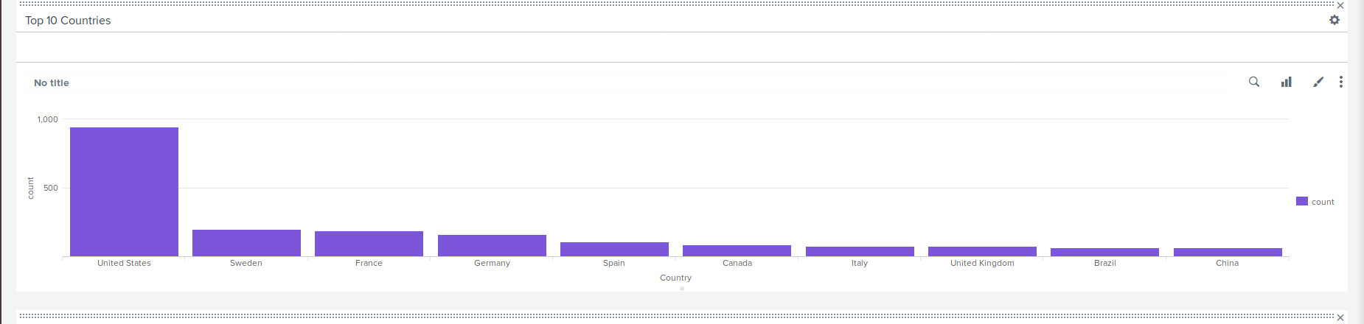
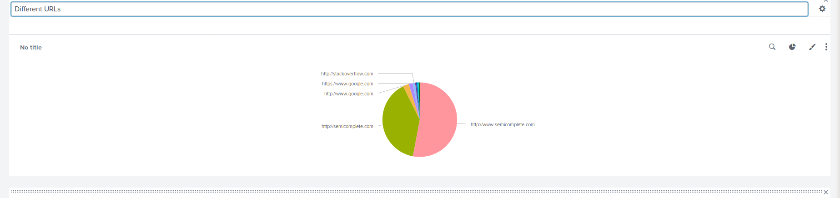
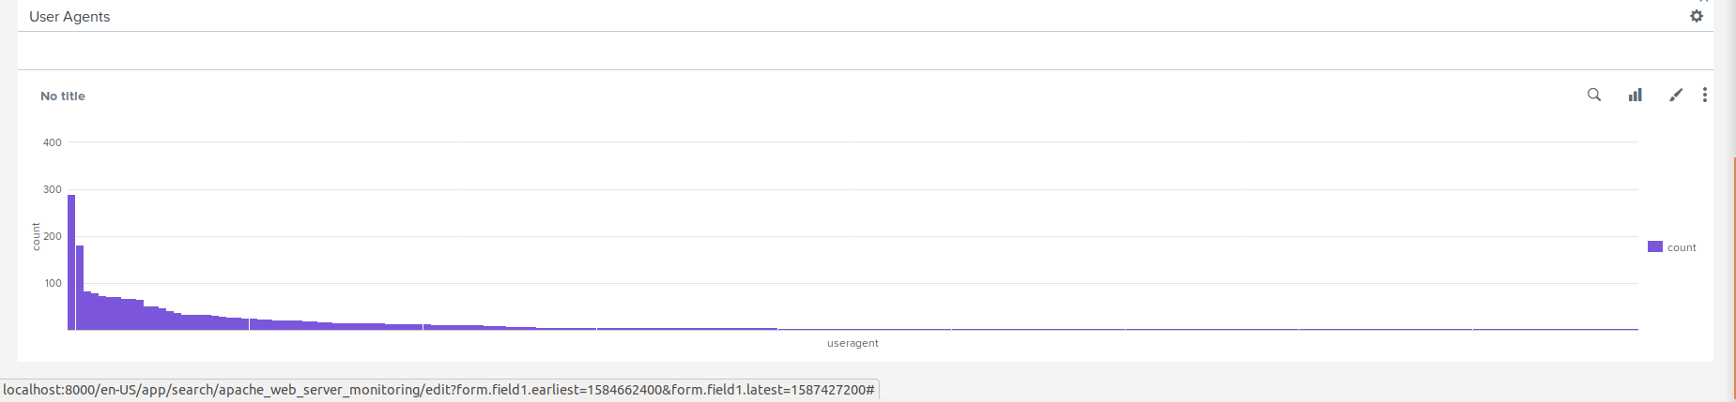
Dashboards—Apache
Place image here
Place image here
Place image here
Place image here

Slide 26
Attack Analysis
‹#›

Slide 27
Attack Summary—Windows
Summarize your findings from your reports when analyzing the attack logs.
High Severity activity increased on the Windows Server drastically from 6.9% to 20.2%
Failed Activity dropped from 2.98% to 1.56%, which is not a drastic change in itself
Based on the two instances of increased High Severity activity and decrease in Failed Activity coinciding, these results may point to a Security Breach

Slide 28
Attack Summary—Windows
Summarize your findings from your alerts when analyzing the attack logs. Were the thresholds correct?
Based on the Alerts set there were multiple breaches to the thresholds set for Successful logins, as well as a threshold breach for Failed Attempts
Between 11:00AM and 12:00PM 196 events occurred. With this being well over our threshold limit, the SOC should have been notified of the situation via email
This increase in Successful Logins continued for the following Alert Window as well, which would have prompted a second email to the SOC
Between 8:00AM to 9:00AM 35 Failed Attempts
Overall we feel confident in the threshold sets within the alerts, and they reflected the activity as intended

Slide 29
Attack Summary—Windows
Summarize your findings from your dashboards when analyzing the attack logs.
Looking at the dashboard, there were two suspicious spikes in activity. A user account was locked out from 12 am to 3 am and An account was successfully logged on from 8 am to 11 am.
During the time of these signature spikes, there were two users who also showed suspicious activity, user_a and user_k.
While looking at the visual displays of data, the results match the time chart for both signatures and users.
We can come to the conclusion that user_a was responsible for an account was locked out and user_k was responsible for an account was successfully logged on.

Slide 30
Attack Summary—Apache
Summarize your findings from your reports when analyzing the attack logs.
HTTP POST Activity (submission or information update attempts) jumped from 1% to 29%
The 404 Response Code increased from 2% to 15% during the attack, which shows the server could not find the intended resource
The 200 Response Code dropped slightly from 91% to 83%, which tells us that successful requests diminished during the attack

Slide 31
Attack Summary—Apache
Summarize your findings from your alerts when analyzing the attack logs. Were the thresholds correct?
There was a large amount of extra activity in Ukraine between 8pm and 9pm on March 25th. There was a total of 935 events. With our threshold being set at 180, this would have caused the alert to be triggered.
At the same time there was also a spike in the POST activity that had 1,296 events. This also would have caused our alert to be set off.

Slide 32
Attack Summary—Apache
Summarize your findings from your dashboards when analyzing the attack logs.
There were two spikes in the GET and POST HTTP methods. GET had a peak of 729, and POST had 1,296
There were two new large volumes of activity coming from Ukraine. Kiev had a count of 440.
The URL of /VSI_Account_Logon.php gained more activity during these attack times. Which leads us to believe they were attempting to brute force the logon page.

Slide 33
Summary and Future Mitigations
‹#›

Slide 34
Project 3 Summary
What were your overall findings from the attack that took place?
Both the Windows and Apache servers were targeted by attackers. On the Windows servers there was an attempted brute force attack based the amount of accounts being locked out and an increased amount of successful logins.
To protect VSI from future attacks, what future mitigations would you recommend?
Use a firewall policy to block spikes from specific locations.
Put stronger password policies in place to prevent successful brute force attacks.

